Slide 1
Ethics
Doing Political Research

Slide 2
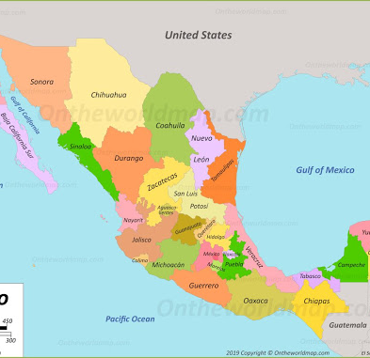
My Recent Experience: A Funding Application
Research question: How do migration and remittances affect experiences and perceptions of corruption in Mexico?
Methods
Representative survey of residents of the 10 municipalities in Mexico with the highest migration rates
Questions on perceptions of corruption eg in the police, health service, education
List experiment to find out which groups were more likely to have paid bribes for public services

Slide 3
The Response
“Whilst the panel found this application interesting, they did not feel it could be supported because they were unable to satisfy themselves from a due diligence perspective that the vulnerable population who would be the participants in the research would not be put at increased risk as a consequence of their involvement in the research.”

Slide 4

ESRC: Six Principles of Ethical Research
Research should be designed, reviewed and undertaken to ensure integrity and quality.
Research staff and subjects must be informed fully about the purpose, methods and intended possible uses of the research, what their participation in the research entails and what risks, if any, are involved.
The confidentiality of information supplied by research subjects and the anonymity of respondents must be respected.
Research participants must participate in a voluntary way, free from any coercion.
Harm to research participants must be avoided.
The independence of research must be clear, and any conflicts of interest or partiality must be explicit.

Slide 5
Ethical Standards
Costs and Benefits
Informed Consent
Privacy, Confidentiality, and Anonymity
Vulnerable Groups

Slide 6

Costs and Benefits
There is never zero cost and risk to participants
Time costs
Seemingly innocuous survey or interview questions could trigger negative emotional responses
Bigger risks (eg reporting of illegal behaviours) require more careful consideration
Balance of costs and benefits
Risks should be mitigated as much as possible

Slide 7

Informed Consent
A description of the study should be provided to participants in advance, describing
the purpose of the research
the expected duration
what is involved
their right to decline to participate and to withdraw from the research once participation has begun
Participants must actively consent
If participants are informed after taking part, there should be a very good reason for doing so eg audit experiments
Notes:
reasonably foreseeable factors that may be expected to influence their willingness to participate such as potential risks, discomfort, or adverse effects; any prospective research benefits; limits of confidentiality; incentives for participation; and whom to contact for questions about the research and research participants’ rights.
Deception is a situation in which subjects have essential information withheld and/or are intentionally misled about procedures and purposes. A thorough debriefing is particularly important in studies involving deception.

Slide 8

Privacy, Anonymity, Confidentiality
Personal information given by the subject should be confidential
Wherever possible, the researcher should take steps to ensure the anonymity of the subjects
Data Protection Act
Notes:
reasonably foreseeable factors that may be expected to influence their willingness to participate such as potential risks, discomfort, or adverse effects; any prospective research benefits; limits of confidentiality; incentives for participation; and whom to contact for questions about the research and research participants’ rights.
Deception is a situation in which subjects have essential information withheld and/or are intentionally misled about procedures and purposes. A thorough debriefing is particularly important in studies involving deception.

Slide 9


Vulnerable Groups
Special care must be taken with vulnerable groups to ensure ethical treatment (eg children, prisoners, people with mental health issues)
Gatekeepers (eg schools, prisons)

Slide 10

Ethical Clashes and Political Research
Who is this research for? - the participants? the funding body? the wider public? knowledge for its own sake?
Should participants be involved in shaping the project?
What if our obligations to the sponsors clash with our obligation to disseminate the results?
Who should be protected when findings are made public?
Does the ethical principle of privacy clash with the integrity principle of research transparency?
How do we deal with on-the-spot ethical decisions that we haven’t planned for?
There are no simple answers

Slide 11

Ethics at Birkbeck
All student and staff research projects involving human participants or sensitive research materials need to apply for ethical approval
Routine research projects are approved by Departmental Research Ethics Officers
Non-routine research (sensitive or extremely sensitive) handled by School/College Ethics Committees
Participants’ physical or mental wellbeing is put at risk
Vulnerable populations are involved
Permission of a gatekeeper is required to access participants
Use of deception or lack of informed consent
Predictable media interest or sensitivity
Conflicts of interest

Slide 12
Conclusion
Ethical issues need to be considered from the very beginning of designing a research project right through to dissemination of the findings
Some issues are easy to deal with; for others, careful reflection is needed
Ethical principles can clash with each other

